Slide 1
Client Graphics
Presenter
Developer Technical Services

Slide 2
Agenda
Definition and Purpose
Object Model
ClientGraphics Data
ClientGraphics Primitives
InteractionGraphics
Advanced topic

Slide 3
Definition and Purpose

Slide 4
Definition
The Inventor API provides the means to place certain graphic on components or in drawing views. These primitives (points, lines, triangles, text, …) collectively referred to as ClientGraphics, will be maintained and transformed by Inventor for the duration of the session only.
ClientGraphics are transient in nature, unlike parts and assemblies. However, ClientGraphics are not destroyed by a screen refresh.
An interesting feature of ClientGraphics is that they will be transformed along with everything else during view changes, zooms, pans, and so on.
Notes:
However, it is possible to specify that they be front facing. So that as the viewpoint changes, the graphics location appears to change too but its planar appearance does not - important for text to remain readable.

Slide 5
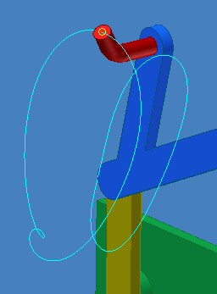
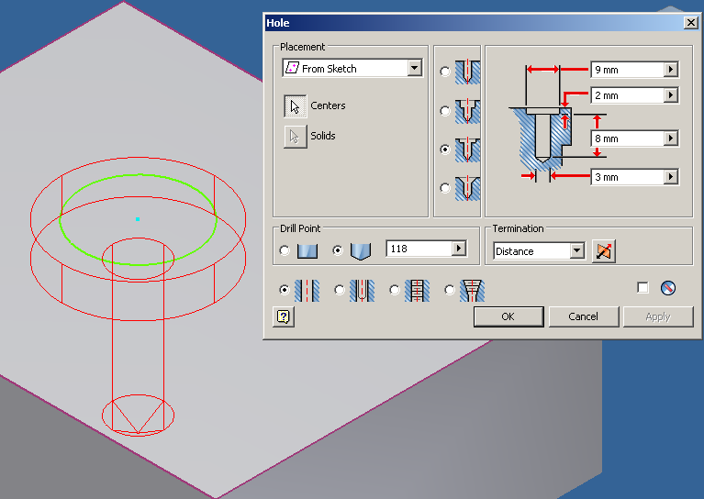
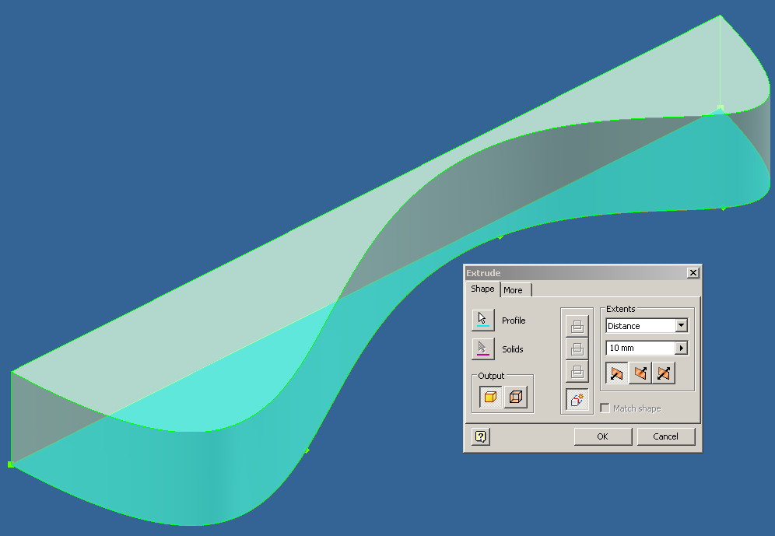
Purpose
Client Graphics allow the developer to provide visual cues to the user.
Inventor does this itself in many commands: extruding a sketch, adding a hole feature, create a revolve, a sweep, …
A developer can provide similar visual cues for their own application.

Slide 6
Why do you need them?
Ability to draw custom graphics alongside Inventor native graphics
Insulate from the underlying graphics platform
Enhance your plug-in commands by integrating visual feedback
Migrate solutions based on OpenGL graphics
Notes:
Insulate from the underlying graphics platform > benefit in terms of
portability and graphic library changes

Slide 7
The applications of ClientGraphics
Client Graphics are widely used in native Inventor commands and add-ins:
Represent custom and transient objects
Create interactive previews during commands
Display the results of various analyses
Creating custom manipulators within a command
Enhance user experience
Notes:
Client Graphics allow the developer to provide visual cues to actions being performed, and Inventor uses this feature itself in many scenarios, e.g. when the user creates an extrusion, a preview of the extruded part is displayed. While defining the extrude feature, a visual cue indicates what the final result will be. Providing such visual cues within your own application add-in will greatly enhance the user experience felt when running your commands.
Client Graphics are widely used in native Inventor commands as well as in add-in applications to:
Represent custom and transient objects
Create interactive previews during the add-in commands
Display the results of various analyses
Creating custom manipulators within a command.
Providing such visual cues within your own application add-in will greatly enhance the user experience felt when running your commands.

Slide 8
Object Model

Slide 9
Object Model
Creating Client Graphics can be considered a two stage process. There are two separate object models, indicated by the following diagrams.
The first stage is to set up the data: most importantly, the list of coordinates your graphics will be based on.
The second stage is to set up the graphics primitives that will use that data.
This separation of data from graphics allows a single set of data to be referenced by several primitives.
Notes:
GraphicsIndexSet object is a way to map a subset of the point data to your required graphics primitives. It contains an indexed list of indices to a data set, essentially creating a new list of coordinates to be passed to the graphics set.

Slide 10
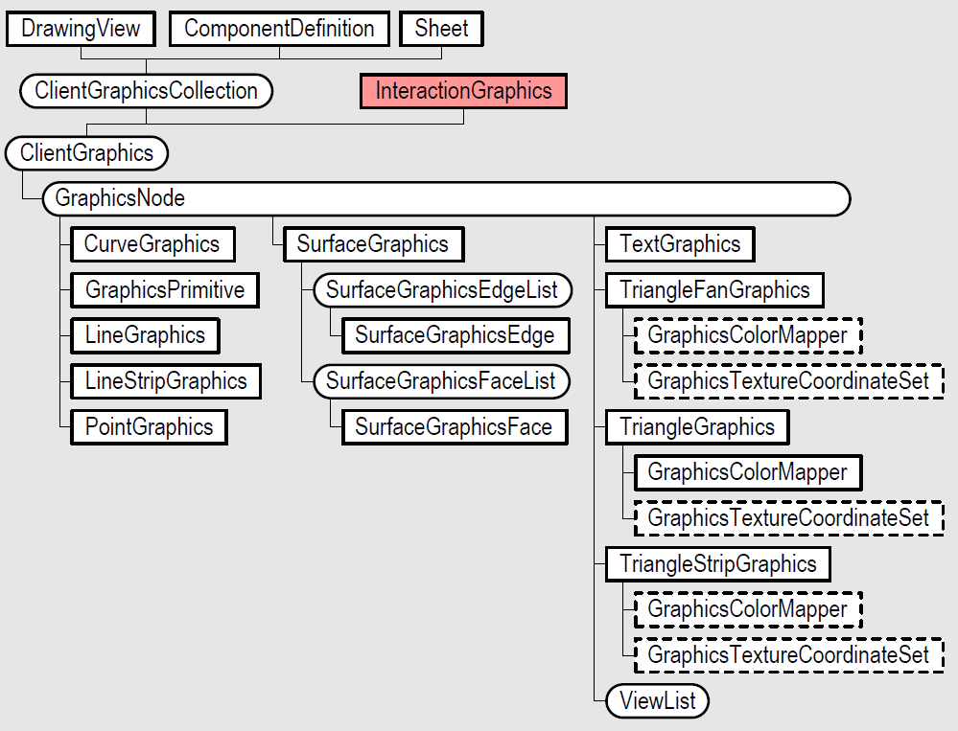
Graphic Objects
ClientGraphics :Owner of a group of graphics. Controls visibility and selectability of the group.
GraphicsNode: Owner of graphics primitives. Controls visibility, selectability, color, and position.
Graphic primitives: The displayed graphics.

Slide 11
GraphicsNode basic properties
GraphicsNode object has some properties to control default behavior of all primitives it contains.
Here are the most important:
Render Style
Visibility
Visible | VisibleInViews | VisibleInActiveEditObject
Selectable
Transformation
Notes:
Basic Properties
A GraphicsNode object has some properties to control the default behavior of all primitives it contains. Here are the most important:
Render Style
By default, the linetype, lineweight and color of the graphics primitives owned by a node will use the settings of the RenderStyle until they are overridden by LineType, LineWeight, Color (for Curve and Surface graphics), and ColorSet (for Line, Triangle and TriangleFan graphics).
Visibility
The Visible property controls and overwrites the visibility of all primitives owned by the node
The VisibleInViews returns an object containing the Views that this graphics node is visible in. If there are no views in the list, the node is visible in all views.
The VisibleInActiveEditObject is a Boolean that gets or sets whether this graphics node is visible when the containing object is not the active edit object.
Selectable
Specifies whether the GraphicsNode object can be selected when the Select command is running in Inventor.
Transformation
A 4x4 transformation matrix that can be used to get or set the transformation of the GraphicsNode. When transforming a node, each graphic primitive it contains will be transformed accordingly.

Slide 12
ClientGraphics Types
Regular ClientGraphics:
Associated with a document
Transient unless owned by a ClientFeature
Can be obtained from different sources :
PartComponentDefinition
AssemblyComponentDefinition
FlatPattern
DrawingView, Sheet
ClientFeatureDefinition
Interaction ClientGraphics:
Only available when InteractionEvents is running
Display preview graphics or manipulators while running a command
Automatically deleted when InteractionEvents terminates
Notes:
Types of Client Graphics
ClientGraphics can be distinguished in two main categories, depending on the object they are invoked from.
Regular Client Graphics
These types of client graphics are associated with an Inventor document. They are transient unless associated with a client feature (we will see more about this in the section “Storing Graphics”), which means they are not retained by the document when the document is closed. They can be associated with the following API objects: PartComponentDefinition, AssemblyComponentDefinition, FlatPattern, DrawingView, Sheet, ClientFeatureDefinition.
Each of the previous objects can have more than one ClientGraphics object associated with it. Each ClientGraphics object can have many graphics nodes and each node can contain any number and any type of GraphicsPrimitive.
Interaction Client Graphics
This type of client graphics is available when using InteractionEvents. They would be used typically to display temporary or preview graphics while running a command and will be automatically deleted as the InteractionEvents terminates, that is when the command is finished or cancelled. They are always transient. Like regular ClientGraphics, the InteractionEvents object can have any number of nodes and graphics primitives.

Slide 13
Client Graphics Data

Slide 14
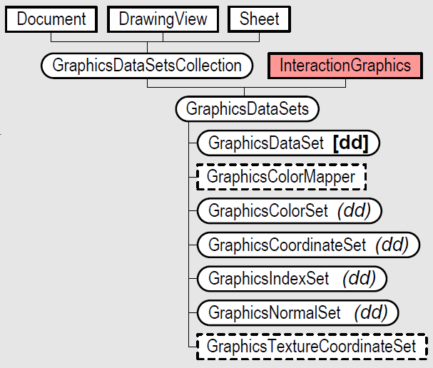
Object Model - Client Graphics Data

Slide 15
Data Objects
Data sets contain the raw information that can be used to define graphics geometry.
GraphicDataSets: Owner object for GraphicsDataSet objects.
GraphicsColorSet: Defines a set of colors.
GraphicsCoordinateSet: Defines a set of coordinate points.
GraphicsIndexSet: Defines a set of Long values that act as an index into the other sets.
GraphicsNormalSet: Defines a set of vectors that will be used as normal vectors.

Slide 16
Graphics Primitives

Slide 17
Object Model - Client Graphics Primitives

Slide 18
GraphicsPrimitives - Common Properties
GraphicsPrimitive objects represent the graphics you can see in Inventor graphic window.
Here are some properties and methods common to all of them:
BurnThrough
DepthPriority
SetViewSpaceAnchor
SetTransformBehavior
Notes:
In this section we take a look in more detail at the GraphicsPrimitives. However before going through each type of primitive, let’s expose a few important properties that are common to all of them:
BurnThrough
This specifies whether or not graphics are always visible even if they are blocked by other objects.
DepthPriority
Property that allows you to specify a display priority to the graphics. This is used in the cases where entities are coincident. The entities with the higher priority will render on top of lower priority entities.
SetViewSpaceAnchor
This will anchor the primitive in view space so that the graphics will display in one fixed position, no matter how the view changes.
SetTransformBehavior
Graphic objects have two special transform behaviors: front facing and pixel scaling. A front facing object does not rotate as the view is rotated but maintains the same orientation on the screen. It is positioned at a specified location within model and its position on the screen will change as the view is zoomed in and out and scrolled, but its orientation will not change.
A graphic object that has pixel scaling behavior maintains the same size relative to the screen. As the user zooms in and out the graphic objects visible size on the screen will remain the same.

Slide 19
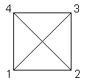
LineGraphics
Public Function AddLineGraphics() As
LineGraphics
Individual line segments.
Coordinate Data: (0,0,0)-(1,0,0) (1,0,0)-(1,1,0) (1,1,0)-(0,1,0) (0,1,0)-(0,0,0) (0,0,0)-(1,1,0) (1,0,0)-(0,1,0)

Slide 20
LineStripGraphics
Public Function AddLineStripGraphics() As
LineStripGraphics
Connected set of lines.
Coordinate Data: (0,0,0),
(1,0,0),
(1,1,0),
(0,1,0),
(0,0,0),
(1,1,0),
(1,0,0),
(0,1,0)

Slide 21

TriangleGraphics
Public Function AddTriangleGraphics() As TriangleGraphics
Individual triangles.
Coordinate Data: (0,0,0)-(2,0,0)-(1,1,0) (2,0,0)-(1,1,0)-(3,1,0) (2,0,0)-(4,0,0)-(3,1,0) (4,0,0)-(5,1,0)-(3,1,0)

Slide 22

TriangleStripGraphics
Public Function AddTriangleStripGraphics() As
TriangleStripGraphics
Connected set of triangles.
Coordinate data: (0,0,0), (1,1,0), (2,0,0), (3,1,0), (4,0,0), (5,1,0), (6,0,0), (8,0,0), (7,1,0), (9,1,0)
Strip lengths: 6, 4

Slide 23
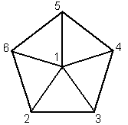
TriangleFanGraphics
Public Function AddTriangleFanGraphics() As
TriangleFanGraphics
Connected set of triangles.
Coordinate data: (2,3,0), (0,0,0), (4,0,0), (5,4,0), (2,6,0), (-1,4,0)
Also supports strip lengths.

Slide 24
Using Coordinate Sets - Index Set
The GraphicsIndexSet object defines the relationship between the points you added in the GraphicsCoordinateSet.
It also allows to optimize the number of data points needed: two identical points can refer to the same data.
Coordinate set: (0,0,0), (1,0,0), (1,1,0), (0,1,0)
Index set for LineGraphics: (1, 2, 2, 3, 3, 4, 4, 1, 1, 3, 2, 4)
Index set for LineStripGraphics: (1, 2, 3, 4, 1, 3, 2, 4) Strip Lengths: (6, 2)

Slide 25
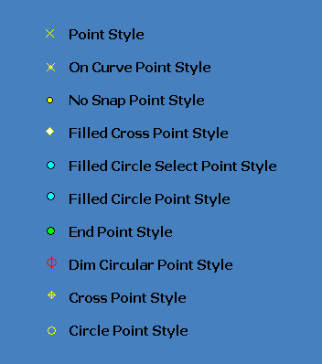
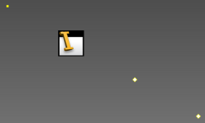
PointGraphics
AddPointGraphics
A point is displayed at each defined coordinate.
Display style can be one of several predefined types.
Can define your own bitmap

Slide 26
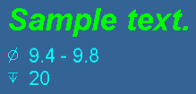
TextGraphics
Public Function AddTextGraphics() As
TextGraphics
Main Properties:
Text As String
Anchor As Point
Bold As Boolean
Font As String
FontSize As Integer
HorizontalAlignment As HorizontalTextAlignmentEnum
Italic As Boolean

Slide 27
Curve Graphics
Public Function AddCurveGraphics (ByVal Curve As Object ) As CurveGraphics
Input Curve object can be one of the following: LineSegment, Circle, Arc3d, EllipseFull, EllipticalArc and BSplineCurve.

Slide 28
Surface Graphics
Public Function AddSurfaceGraphics( ByVal Surfaces As Object ) As SurfaceGraphics
Input Surfaces object can be one of the following: SurfaceBody, Face, Faces or a FaceCollection object.
The various body primitive creation methods of the TransientBrep can be used as input as well.
Notes:
If a FaceCollection is provided, all the Face objects in the collection must belong to the same SurfaceBody, else an error will occur.

Slide 29
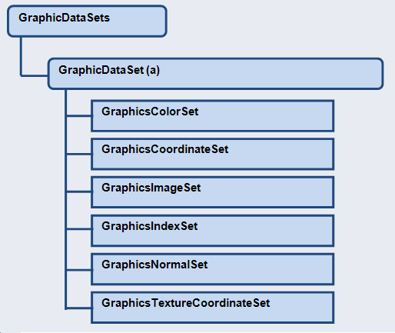
Primitives and GraphicsData
GraphicsDataSets allow to create
data input for primitives that need it
They are also used to customize
primitives with colors,
textures or images
Specific GraphicDataSet objects
are created from the GraphicsDataSets collection
Notes:
{Code DEMO: IndexSetDemo}
[DEMO: Index Set]
[DEMO: Point Graphics]
[DEMO: Text Graphics]
[DEMO: Triangle Strip Graphics]

Slide 30
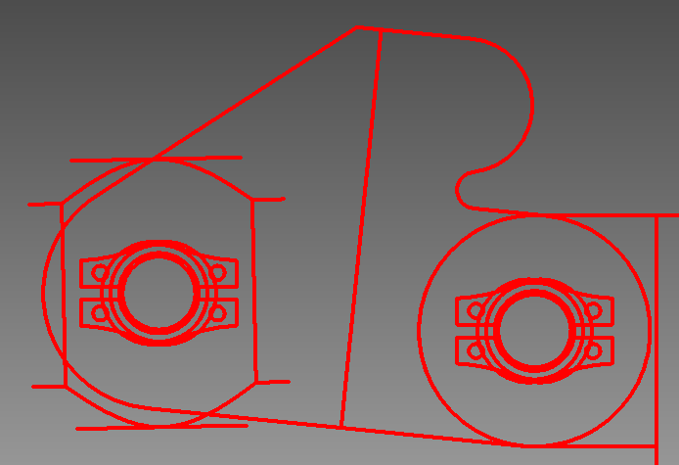
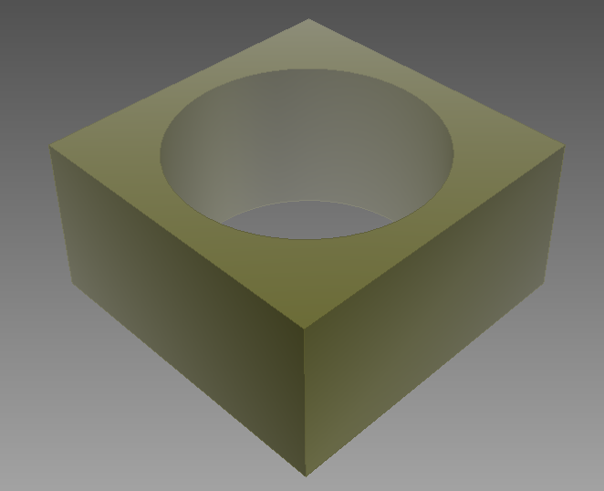
Reusing native model data
CurveGraphics
Can use geometry of edges from model: Edge.Geometry
or curves generated by TransientGeometry
SurfaceGraphics
Can use SurfaceBody from model
or solids generated by TransientBRep
ComponentGraphics
Can use any loaded ComponentDefinition
from Part or Assembly
Notes:
[DEMO: Surface Graphics]
[DEMO: Curve Graphics] (Section Manager Graphics)
[DEMO: ComponentGraphics Interaction] (Section Interaction Graphics)

Slide 31
Interaction Graphics

Slide 32
InteractionGraphics Object
InteractionGraphics operates in a similar manner to regular ClientGraphics, except that it's in the context of InteractionEvents only.
ClientGraphics via InteractionGraphics are much faster and so are well suited to real-time feedback during a command.
InteractionGraphics are automatically removed once the associated InteractionEvents object stops.
Access from InteractionEvents.InteractionGraphics Property.

Slide 33
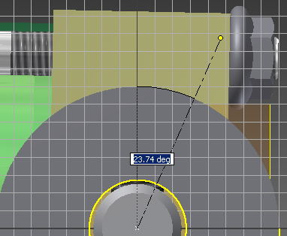
Overlay vs Preview Graphics
InteractionGraphics can use Preview or Overlay graphics:
Preview graphics = equivalent to regular ClientGraphics (non-transacting)
Overlay graphics = draw independently in a special «overlay» plane
Use:
Overlay graphics can be much faster
when Inventor model view is stationary
and only graphics need to be updated.
Example:
Result preview in sketch environment
Notes:
The interaction graphics can be Preview or Overlay. Preview graphics are equivalent to regular Client Graphics, but when an InteractionEvents is running. Overlay graphics are drawn independently, in a single view (window), and then merged with the last full redraw of the scene by drawing the graphics in a special "overlay" plane. It doesn't mean that the graphics are always drawn on top. You can position them anywhere you want and you can toggle the "burn through" option.
Overlay graphics can be much faster than Preview graphics in case the view is stationary and you need to draw some temporary graphics. For example, Inventor uses overlay graphics in the sketch commands to do rubber banding to show the possible results. The rest of the view is typically stationary with the dynamic preview being the only graphics changed. The reason this is faster is that Inventor calculates the entire view and caches it along with the z-buffer. When you draw overlay graphics the cached scene is copied and the overlay graphics are applied. Only the overlay graphics are being recalculated. For preview graphics, the client graphics created are added to the standard scene and are rendered with all of the other Inventor graphics. Modifying the graphics causes the entire scene to re-rendered. Because of how overlay graphics are done internally, they are not selectable. If selection is desired then you need to create preview graphics.
[DEMO: CircleJig Interaction]

Slide 34
Advanced Topics

Slide 35
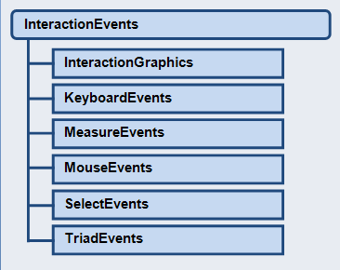
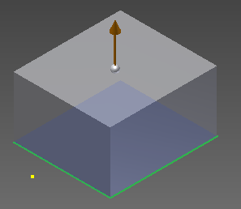
Command Manipulators
Various InteractionEvents sub-events
can be used to handle manipulators within
your command
GraphicsPrimitive.SetTransformBehavior
Can be used to generate constant size
and/or front facing graphics
SetTransformBehavior(
Point Anchor,
DisplayTransformBehaviorEnum BehaviorType,
double PixelScale)
Notes:
[DEMO: VB.Net Sample]

Slide 36
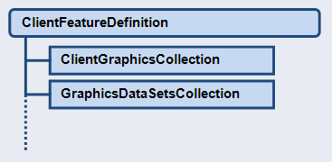
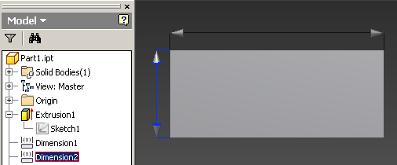
Storing Graphics
ClientGraphics are transient by nature
The only way to persist them across sessions are:
Recreate them with your application logic when document is open
Host the graphics inside a ClientFeature
Notes:
[DEMO: ClientFeature Graphics]
[DEMO: Dimension Graphics]

Slide 37
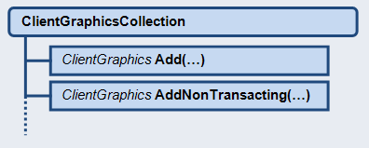
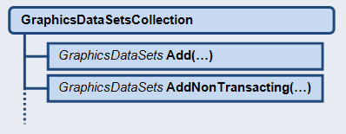
Transacting vs Non-Transacting Graphics
New non-transacting graphics functionality added in 2012
Non-transacting graphics are now available outside of InteractionEvents
Graphics that do not require undo/redo can be drawn much faster
if not transacting
Notes:
[DEMO: Dynamic Simulation Graphics]

Slide 38
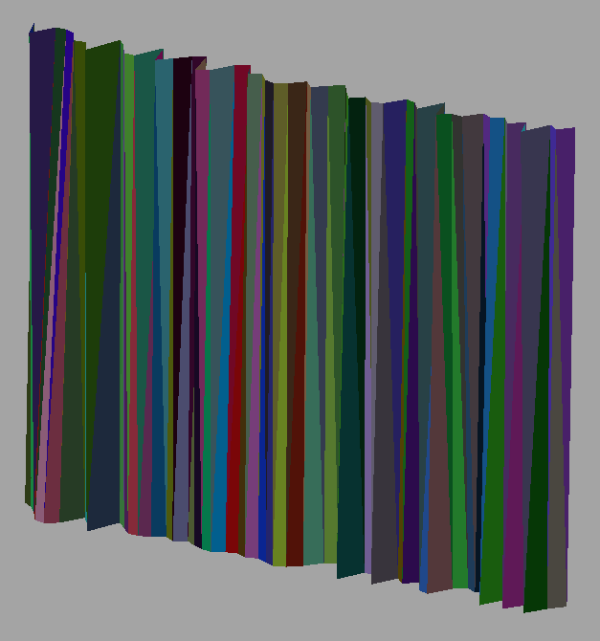
Non-Transacting Client Graphics
Support for non-transacting client graphics. (from 2012)
No undo support.
Significantly faster than transacting client graphics.
Sample creates 1000 unique triangles with accompanying coordinates, normals, etc.
Transacting: 17.52 sec.
Non-transacting: 0.159 sec.
Over 100 times faster.
Notes:
Demo: NonTransactingGraphics
Change the value of the createAsTransacting variable to have it create transacting client graphics.

Slide 39
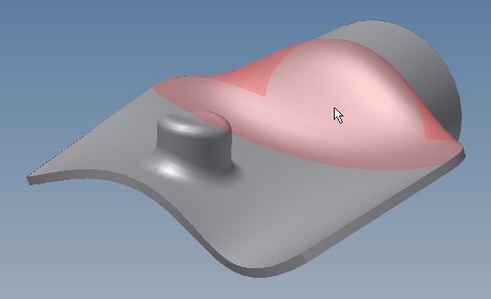
Client Graphics – Selection (from 2013)
GraphicsNode.DisplayName
used when the user is selecting and uses the “Select Other” functionality.
The name is what’s displayed in the list of selectable entities.
In previous versions of Inventor, the client graphics object that was selectable was the graphics node. From 2013, allows graphic primitives to be selected
SurfaceGraphics.ChildrenAreSelectable SurfaceGraphics.DisplayedVertices SurfaceGraphicsVertexList SurfaceGraphicsVertex SurfaceGraphicsVertex.Selectable SurfaceGraphicsEdge.Selectable SurfaceGraphicsFace.Selectable
Notes:
The display name of a node is used when the user is selecting and uses the “Select Other” functionality. This name is what’s displayed in the list of selectable entities.
In previous versions of Inventor, the client graphics object that was selectable was the graphics node. This was fairly heavy in some cases where many selectable objects needed to be created. This new functionality allows graphic primitives to be selected. These are the various line, triangle, and point graphics, and also the B-Rep components that make up a SurfaceGraphics instance.

Slide 40
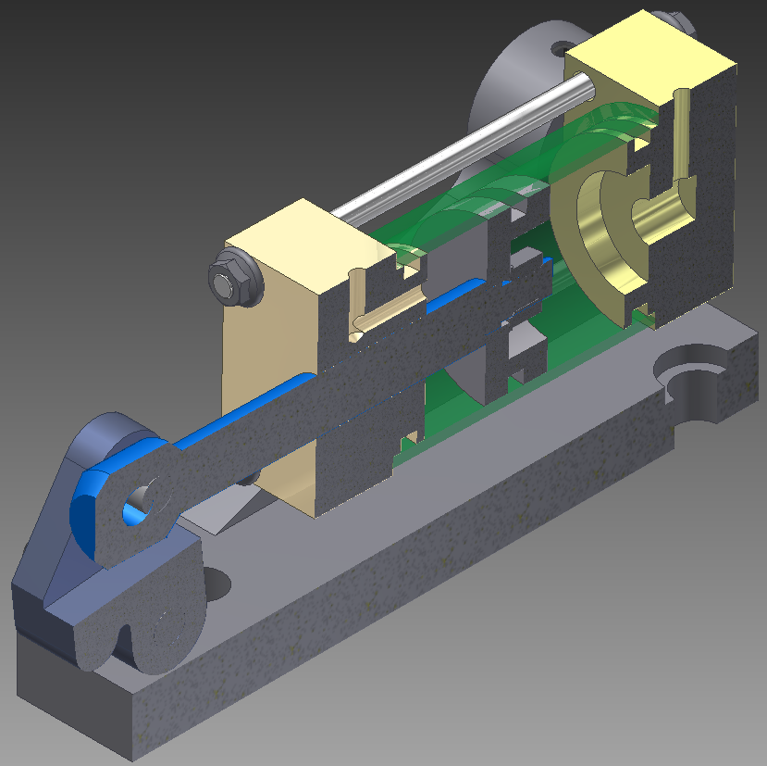
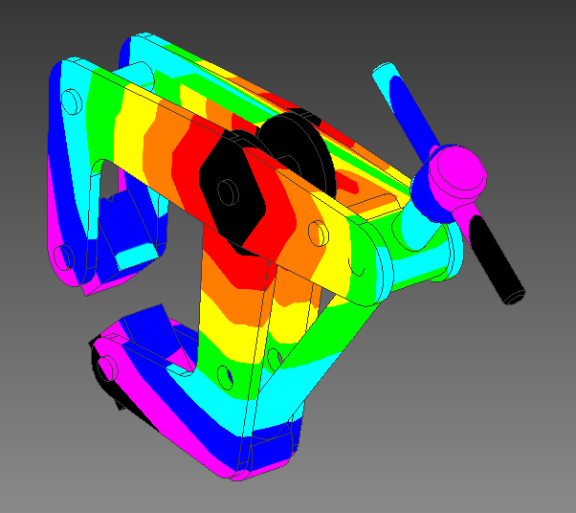
Miscellaneous functionalities
Slicing
Texture Mapping
Notes:
Slicing
The GraphicsNode.SliceGraphics method offers the possibility to slice all the primitives owned by a node based on the input planes and optionally cap the sliced end, see picture below.
Texture mapping
Texture mapping provides the ability to accurately define color mapping to the model. The GraphicsColorMapper object maps scalar values to colors. Use methods provided on the object to define the scalar values and colors. The same object can be used to define the mapping for multiple graphics primitives using the ColorMapper property on the primitives.
[DEMO: Slice Graphics Interaction]

Slide 41

Notes:
Thank you!
Questions?

